Slide 1


REFERENCING IN ACADEMIC PUBLICATIONS​ Peter, S., Riemer, K., Norman, P. (2025). The 2026 Skills Horizon. Sydney Executive Plus, The University of Sydney, https://doi.org/10.25910/xrre-x449
​
REFERENCING ON SOCIAL MEDIA​ Please include the report URL: plus.sydney.edu.au/horizon

Slide 2
5 messy shifts
01
The values shift Fractured values and fragmenting expectations
02
The technology shift Strategic necessities with no clear direction
03
The accountability shift Accountability across boundaries and the provenance economy
04
The trust shift The erosion of trust in institutions,
ideas and geopolitical stabilities
05
The energy shift An inelegant transition without
a coherent story

Slide 3
Four clashes
to balance
Policy vs. People
You want organised flexibility
Efficiency vs. Expertise
You want to move fast,and not break things
Capability vs. Control
You want all the power, with none of the risk
Abundance vs. Attention
You want to focus on everything

Slide 4
Build a skills-based learning organisation
01
CLASH LABS
Bring your team together to explore how the four Clashes are playing out for your organisation to gain insights on where preparation is needed.
02
SKILLS MAPPING
Map your leaders’ and teams’ preparedness against the skills on the three horizons. Grade skills for criticality and impact against your strategic priorities.
03
HORIZON UPDATES
Ask your team to track your organisation’s skills depth against the Skills Horizon with quarterly updates.
04
THE ECOSYSTEM PLAY
Make upskilling conversations a part of your partner relationships, deepening your connection and building capability together to strengthen your ecosystem.

Slide 5
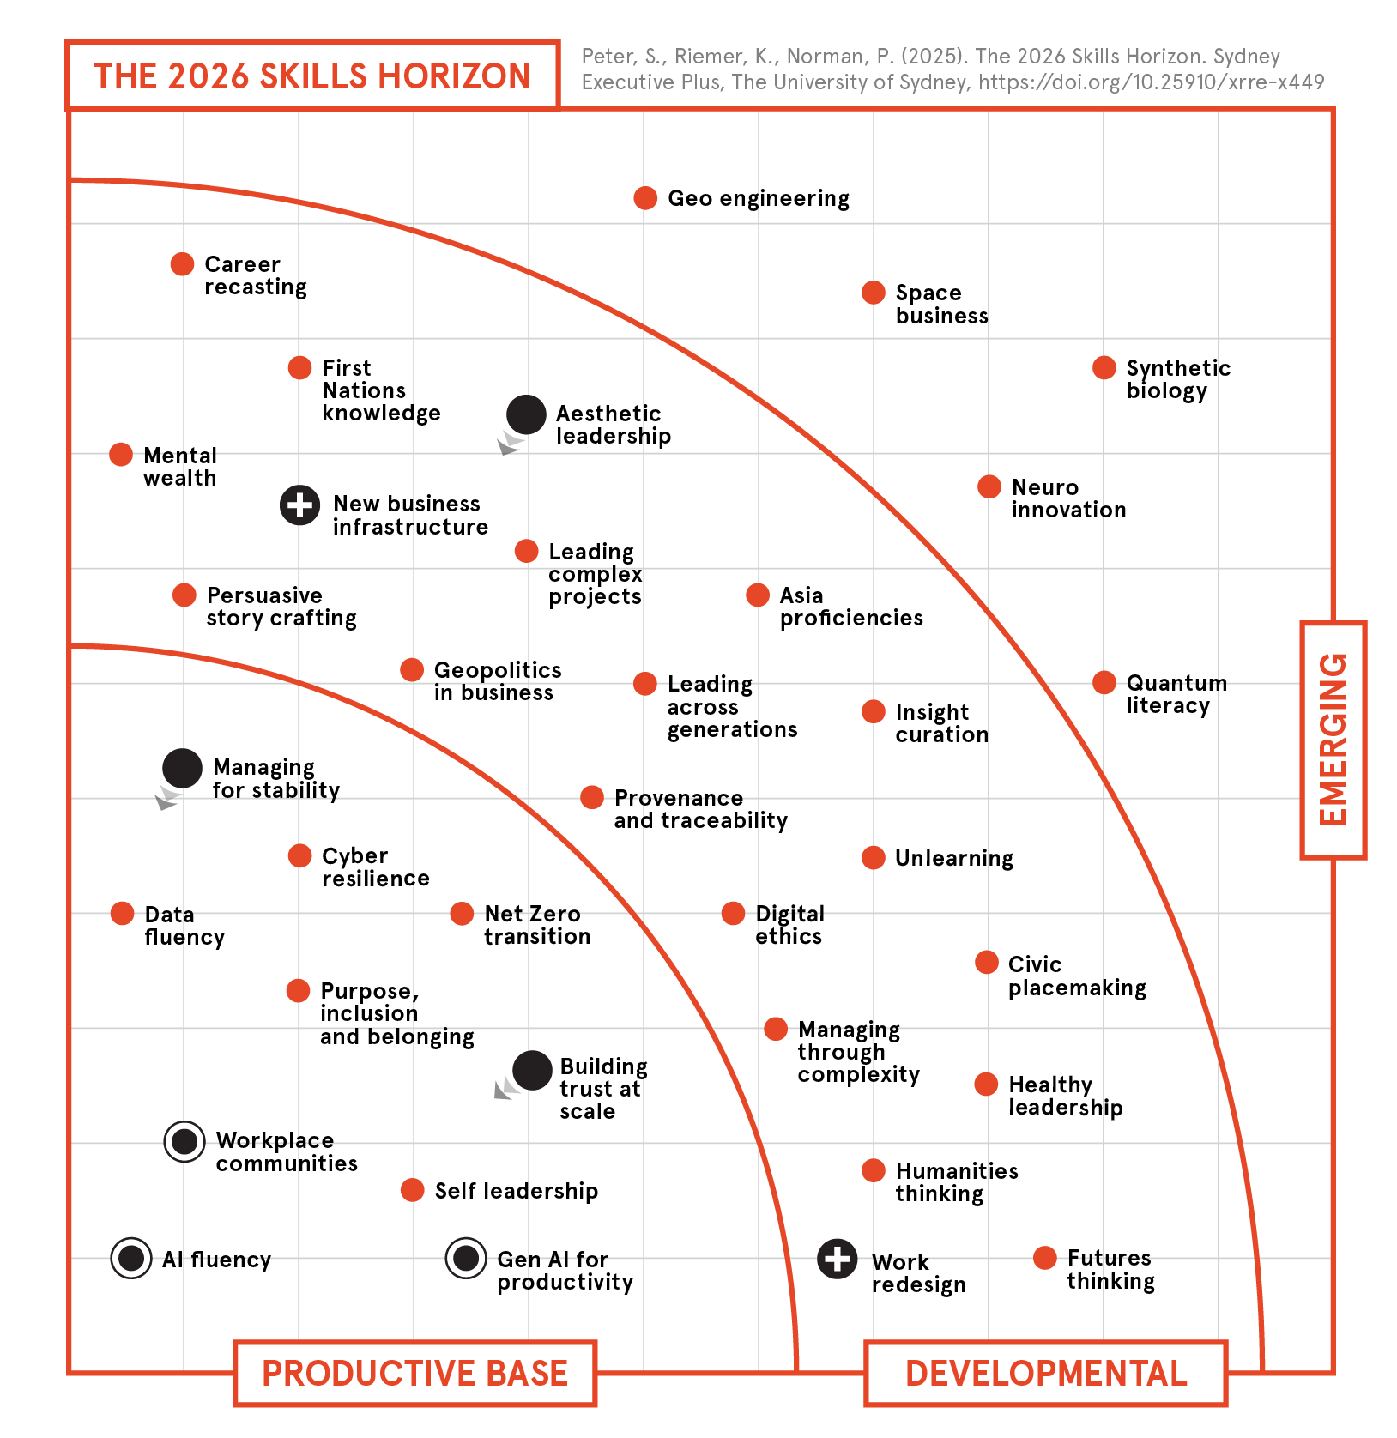
The 2026
Skills Horizon

Slide 6
P
Working in Paris
PROBLEM SOLVING: Facilitate rapid-help channels
and expert office hours so people don’t get stuck with
problems waiting for scheduled meetings.
A
APPRENTICESHIPS: Formalise what was once informal
learning—record key meetings, have senior staff share
their thinking, have official coaching arrangements.
R
RELATIONSHIPS: Build trust deliberately through nonwork interactions, meaningful check-ins, and strategic
coffee chats. And bring people together regularly.
I
INFORMATION DISCOVERY: Recreate serendipity by sharing broader context, encouraging “thinking out loud” in
shared online spaces, and cross-pollinating insights.
S
SENSEMAKING: Invest in collective understanding
through regular “what does this mean for us?” sessions and cross-team perspective sharing.

Slide 7




The five elements of meaningful work
Mastery
Autonomy
Task
Integrity
Connectedness
Significance

Slide 8
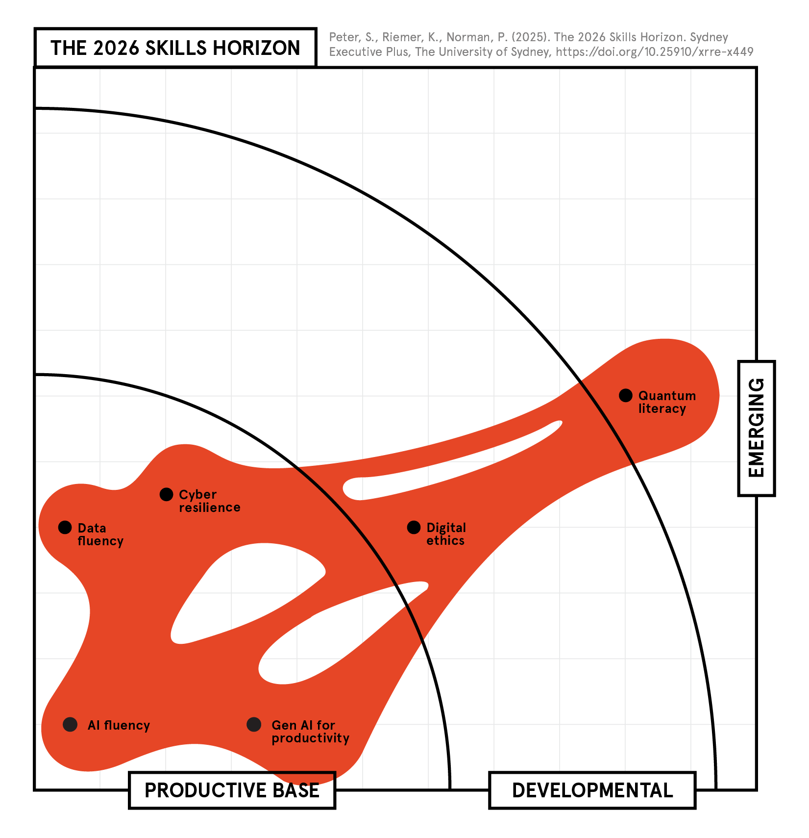
BLOB 1
Speaking the language of tech
You need to make it work.

Slide 9
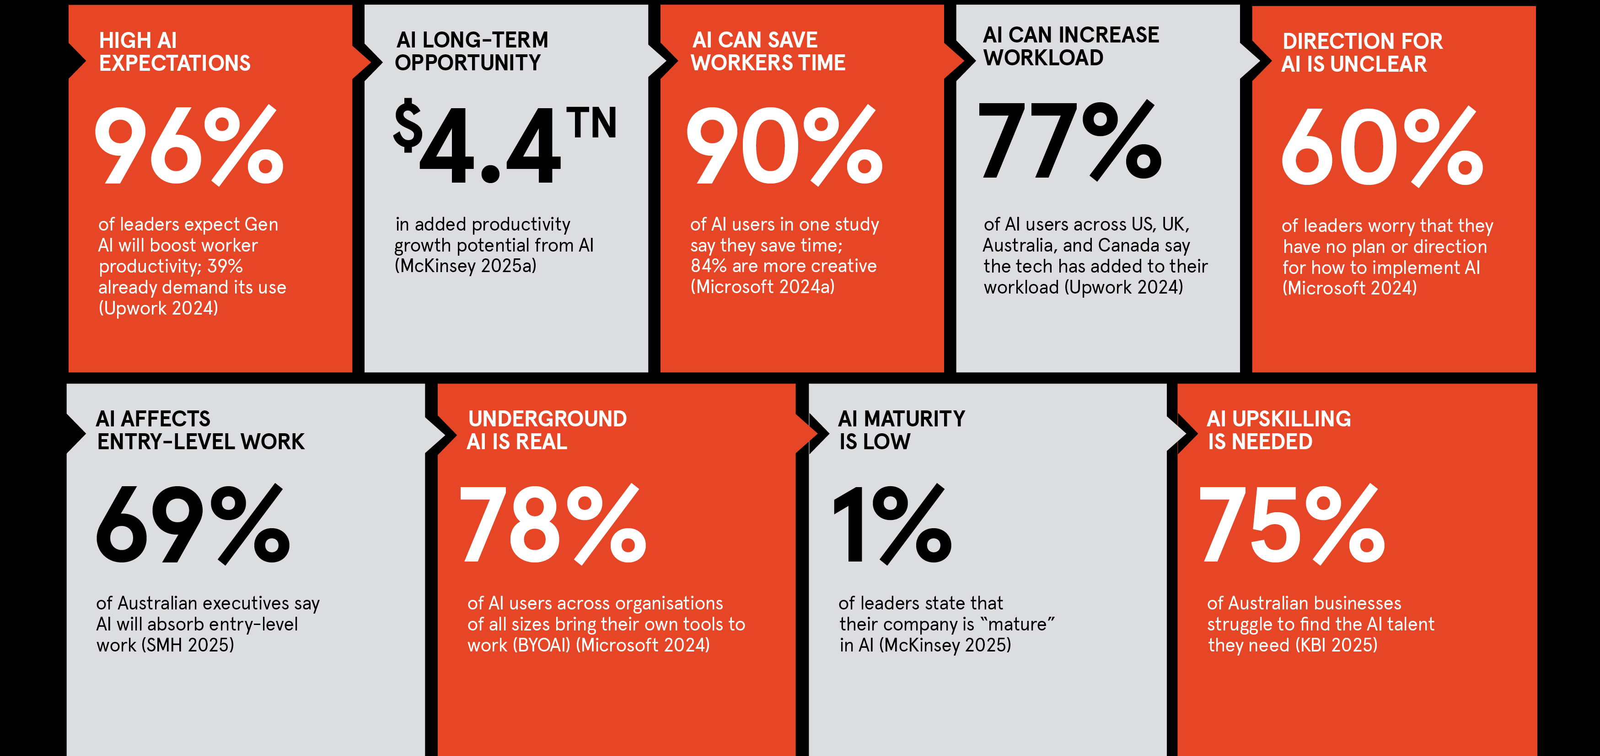
Speaking the language of tech, in numbers
Notes:
Upwork 2024: From Burnout to Balance: AI-Enhanced Work Models, Upwork, 23 Jul 2024: https://www.upwork.com/research/ai-enhanced-work-models
McKinsey 2025a : Superagency in the workplace: Empowering people to unlock AI’s full potential at work, McKinsey & Company, 28 Jan 2025: https://www.mckinsey.com/capabilities/mckinsey-digital/our-insights/superagency-in-the-workplace-empowering-people-to-unlock-ais-full-potential-at-work
Microsoft 2024a : AI at work is here. Now comes the hard part., Microsoft Worklab, 8 May 2024: https://www.microsoft.com/en-us/worklab/work-trend-index/ai-at-work-is-here-now-comes-the-hard-part
SMH 2025: Learn to code? Maybe not any more, The Sydney Morning Herald, 31 Aug 2025: https://www.smh.com.au/technology/learning-to-code-was-the-golden-ticket-to-a-six-figure-salary-perhaps-no-longer-thanks-to-ai-20250827-p5mq8y.html
KBI 2025: AI skills could boost Australia workers’ salaries by more than 29% and accelerate career growth, as AI adoption ramps up, finds new research, KBI Media, 21 Mar 2025: https://kbi.media/ai-skills-could-boost-australia-workers-salaries-by-more-than-29-and-accelerate-career-growth-as-ai-adoption-ramps-up-finds-new-research/

Slide 10
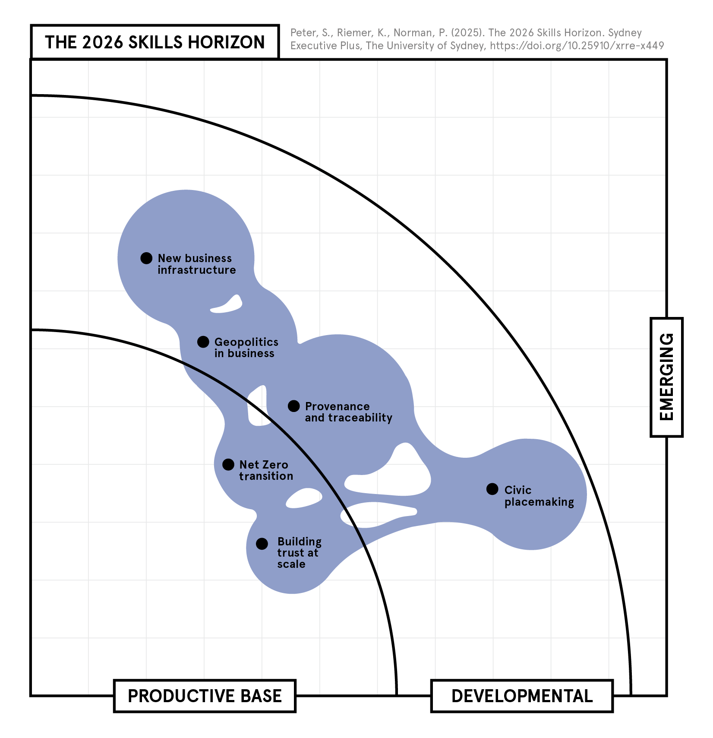
BLOB 2
Solving problems
of scale
You need to trust and be trusted.

Slide 11
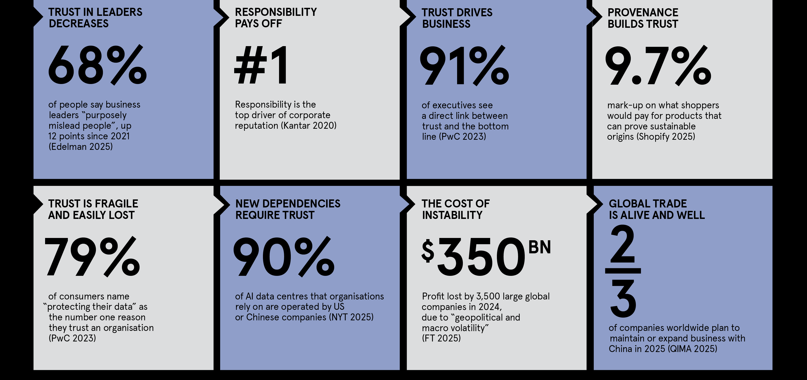
Solving problems of scale, in numbers
Notes:
Edelman 2025: 2025 Edelman Trust Barometer: Trust and the Crisis of Grievance, Edelman, Jan 2025: https://www.edelman.com/trust/2025/trust-barometer
Kantar 2020: The evolution of purpose, Kantar, 27 Aug 2020: https://www.kantar.com/inspiration/brands/the-evolution-of-purpose
PwC 2023: PwC’s 2023 Trust Survey, PwC, Mar 2023: https://www.pwc.com/us/en/library/trust-in-business-survey-2024/pwc-trust-survey-2023.pdf
Shopify 2025: Sourcing for Sustainability: How to Build a Transparent Supply Chain, Shopify, 31 May 2025: https://www.shopify.com/enterprise/blog/supply-chain-transparency
NYT 2025: The Global A.I. Divide, The New York Times, 21 Jun 2025: https://www.nytimes.com/interactive/2025/06/23/technology/ai-computing-global-divide.html
FT 2025a : Political and economic volatility wipes $320bn off global profits, Financial Times, 20 Jul 2025: https://www.ft.com/content/34b387e4-ea54-419c-a4b6-b6f9f72cd9d0
QIMA 2025: Global Supply Chains in 2025, QIMA, 2025: https://www.qima.com/whitepaper/2025-global-sourcing-survey

Slide 12
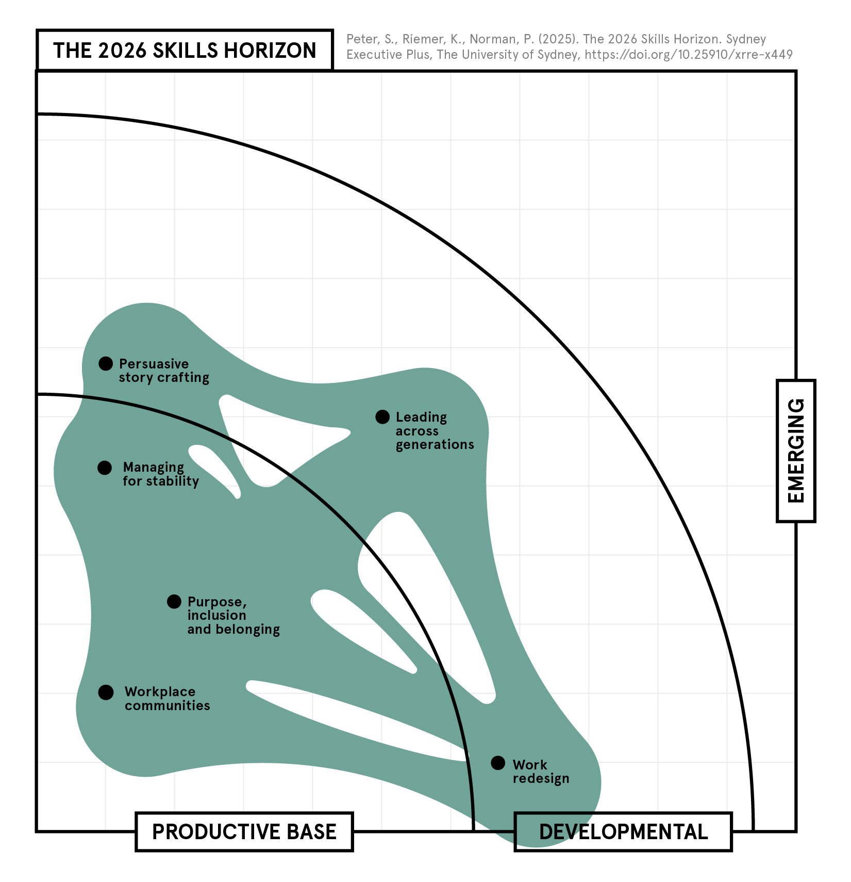
BLOB 3
Working across difference
You need to change for stability.

Slide 13
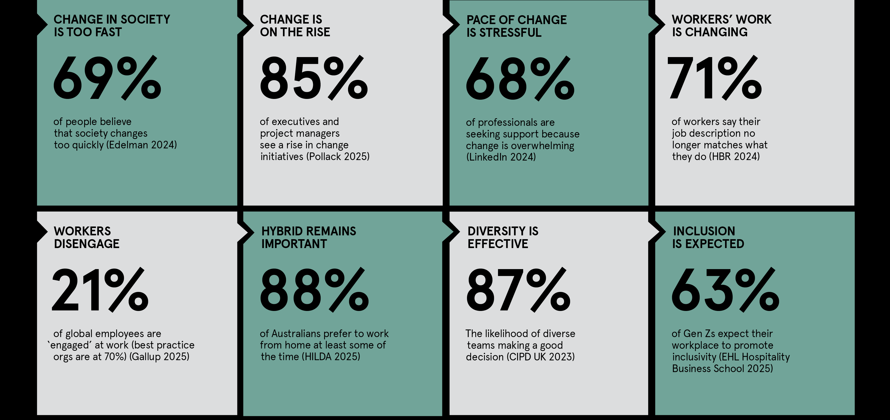
Working across difference, in numbers
Notes:
Edelman 2024: 2024 Edelman Trust Barometer: Innovation in Peril, Edelman, Jan 2024: https://www.edelman.com/trust/2024/trust-barometer
Pollack 2025: 52 Change Management Statistics, Pollack Peacebuilding Systems, 6 Apr 2025: https://pollackpeacebuilding.com/blog/change-management-statistics/
LinkedIn 2024: Nearly two-thirds of professionals are overwhelmed by workplace change, LinkedIn Corporate Communications, 2 Oct 2024: https://news.linkedin.com/2024/October/overwhelmed-by-workplace-change
HBR 2024: Highly Skilled Professionals Want Your Work, But Not Your Job, Harvard Business Review, May-Jun 2024: https://hbr.org/2024/05/highly-skilled-professionals-want-your-work-but-not-your-job
Gallup 2025: State of the Global Workplace Report, Gallup, 2025: https://www.gallup.com/workplace/349484/state-of-the-global-workplace.aspx
HILDA 2025: The Household, Income and Labour Dynamics in Australia (HILDA) Survey, Melbourne Institute of Applied Economic and Social Research, 2025: https://melbourneinstitute.unimelb.edu.au/hilda/publications
CIPD UK 2023: Diversity drives better decisions, CIPD, 2023: https://www.peoplemanagement.co.uk/article/1742042/diversity-drives-better-decisions
EHL Business School 2025: Rethinking Inclusion in the Workplace: Gen Z at Women in Leadership, EHL Insights, 4 Jun 2025: https://hospitalityinsights.ehl.edu/inclusion-workplace-gen-z

Slide 14
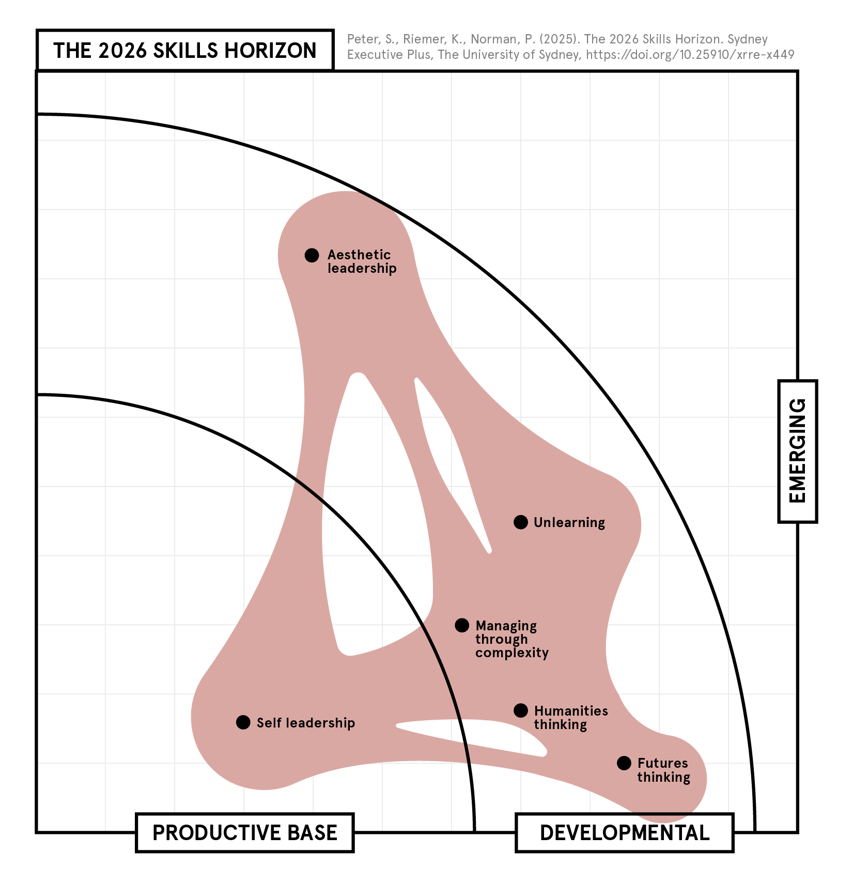
BLOB 4
Thinking through
complexity
You need to do less, with more.

Slide 15
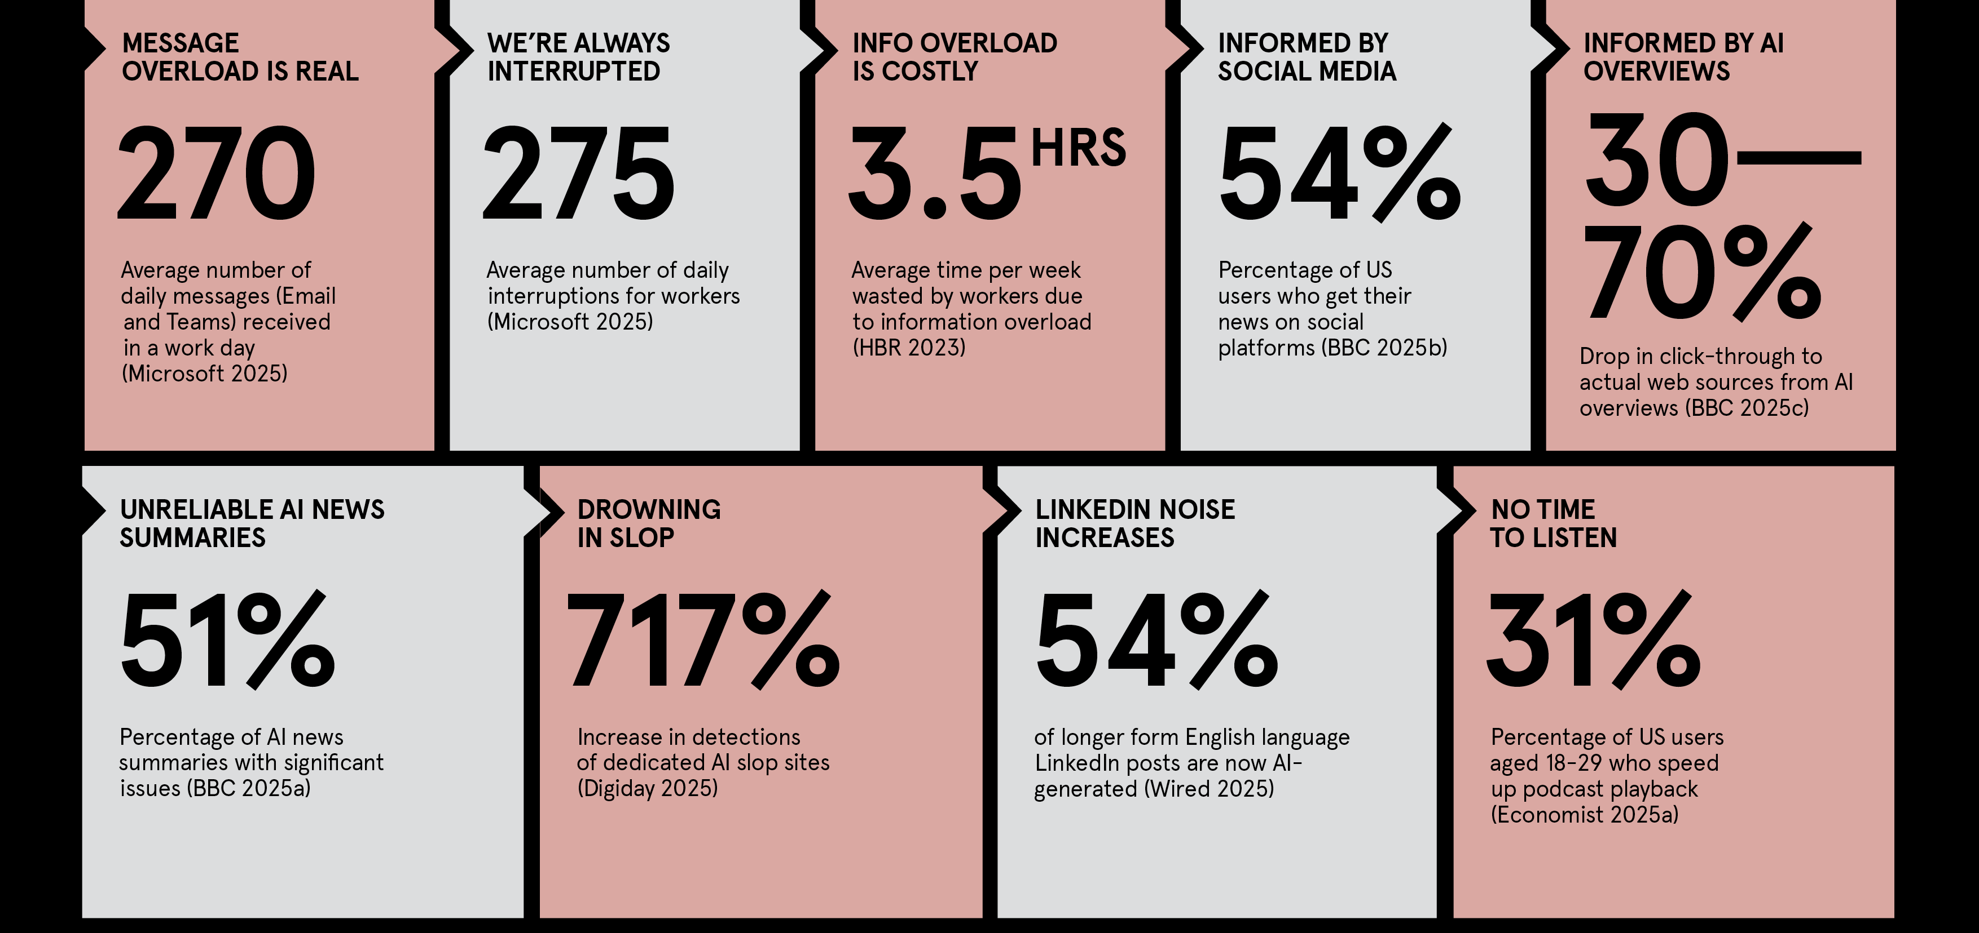
Thinking through complexity, in numbers
Notes:
Microsoft 2025: Breaking down the ‘infinite workday’, Microsoft WorkLab, 17 Jun 2025: https://www.microsoft.com/en-us/worklab/work-trend-index/breaking-down-infinite-workday
HBR 2023: Reducing Information Overload in Your Organization, Harvard Business Review, 1 May 2023: https://hbr.org/2023/05/reducing-information-overload-in-your-organization
BBC 2025b: Social media now main source of news in US, research suggests, BBC News, 17 Jun 2025: https://www.bbc.com/news/articles/c93lzyxkklpo
BBC 2025c: You might be ghosting the internet. Can it survive?, BBC News, 28 Jul 2025: https://www.bbc.com/future/article/20250728-you-might-be-ghosting-the-internet-can-it-survive
BBC 2025a: AI chatbots unable to accurately summarise news, BBC finds, BBC News, 12 Feb 2025: https://www.bbc.com/news/articles/c0m17d8827ko
Digiday 2025: WTF is AI slop doing to warp media metrics?, Digiday, 2 Jun 2025: https://digiday.com/media/wtf-is-ai-slop-doing-to-warp-media-metrics/
Wired 2025: Yes, That Viral LinkedIn Post You Read Was Probably AI-Generated, Wired, 26 Nov 2025: https://www.wired.com/story/linkedin-ai-generated-influencers/
Economist 2025a : What's your preferred playback speed: 1x, 1.5x or 2x?, The Economist, 13 Aug 2025: https://www.economist.com/culture/2025/08/13/whats-your-preferred-playback-speed-1x-15x-or-2x

Slide 16







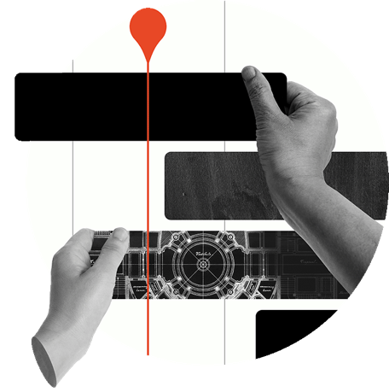
You’ve got the slides. Now get the skills.
AI fluency
Build an understanding of the opportunities, capabilities and challenges of AI and engage confidently with key stakeholders.
AI fluency for directors
Drive meaningful board conversations about AI governance, risk, and strategic direction.
Net Zero
Leading tech-enabled teams
Learn how to account, report and act on your business’ carbon emissions and make the transition to Net Zero.
Create an effective team that thrives in a tech-driven world and transform your leadership for the AI era.
Learn strategies and tools for navigating geopolitical risk, international politics and the global economy.
Geopolitics
and business
Quantum
opportunities
Understand quantum computing and prepare your organisation for the opportunities and risks of quantum disruption.
Leading
complex
projects
Communities
at work
Enhance skills in navigating complexity and driving success in large-scale projects across various sectors.
Learn the techniques to lead with community-building and create an engaged, productive, and purposeful work culture.
Learn more and enrol: plus.sydney.edu.au/our-sprints/
Get in touch with us: executive.plus@sydney.edu.au
Notes:
https://plus.sydney.edu.au/our-sprints/

