Slide 1

REFERENCING IN ACADEMIC PUBLICATIONS​
Peter, S., Riemer, K., Norman, P. (2026).
The 2027 Skills Horizon. Sydney Executive Plus,
The University of Sydney, https://doi.org/10.25910/d443-2a97
​
REFERENCING ON SOCIAL MEDIA​
Please include the report URL:
plus.sydney.edu.au/horizon
Notes:
Slides in this pack are shared under a Creative Commons CC BY-ND licence.
Learn more about what this means: https://creativecommons.org/licenses/by-nd/4.0/
REFERENCING IN ACADEMIC PUBLICATIONS​
Peter, S., Riemer, K., Norman, P. (2026).
The 2027 Skills Horizon. Sydney Executive Plus,
The University of Sydney, https://doi.org/10.25910/d443-2a97
​
REFERENCING ON SOCIAL MEDIA​
Please include the report URL:
plus.sydney.edu.au/horizon

Slide 2
6 messy shifts
01
02
03
The values shift
Misaligned values and
fragmenting expectations
The technology shift
Strategic necessities with
no clear direction
The accountability shift
Accountability becomes multidirectional and multidimensional
04
05
06
The energy shift
The new infrastructure
of the digital economy
The trust shift
Eroding foundations and
shrinking circles of trust
The information shift
Lost in a synthetic sea

Slide 3

Build a skills-based learning organisation
01
SKILLS MAPPING
Begin by using the Skills Horizon to take stock. Map your leaders’ and teams’ preparedness against the skills across the three horizons. Grade skills for criticality and impact against your own strategic priorities. Consider reporting regularly on your skills depth and future readiness.
02
PROVOCATION GAMES
Games are fun and create safe spaces for imaginative learning. Integrate a structured provocation exercise into your next executive, board, or team meeting. Present a challenging provocation and allow space for your team to explore it.
03
SHARED HORIZONS
Your L&D strategy works best when your team are curious, engaged, and take ownership of it. Create opportunities for team members to share their personal Skills Horizon: ask which skills they’re working on and why. Make lifelong learning a living conversation in your business.
04
THE ECOSYSTEM PLAY
You aren’t building these skills alone: you’re working alongside partners, vendors, and clients. Make upskilling conversations a part of these relationships, deepening your connection and building capability together to strengthen your ecosystem.

Slide 4
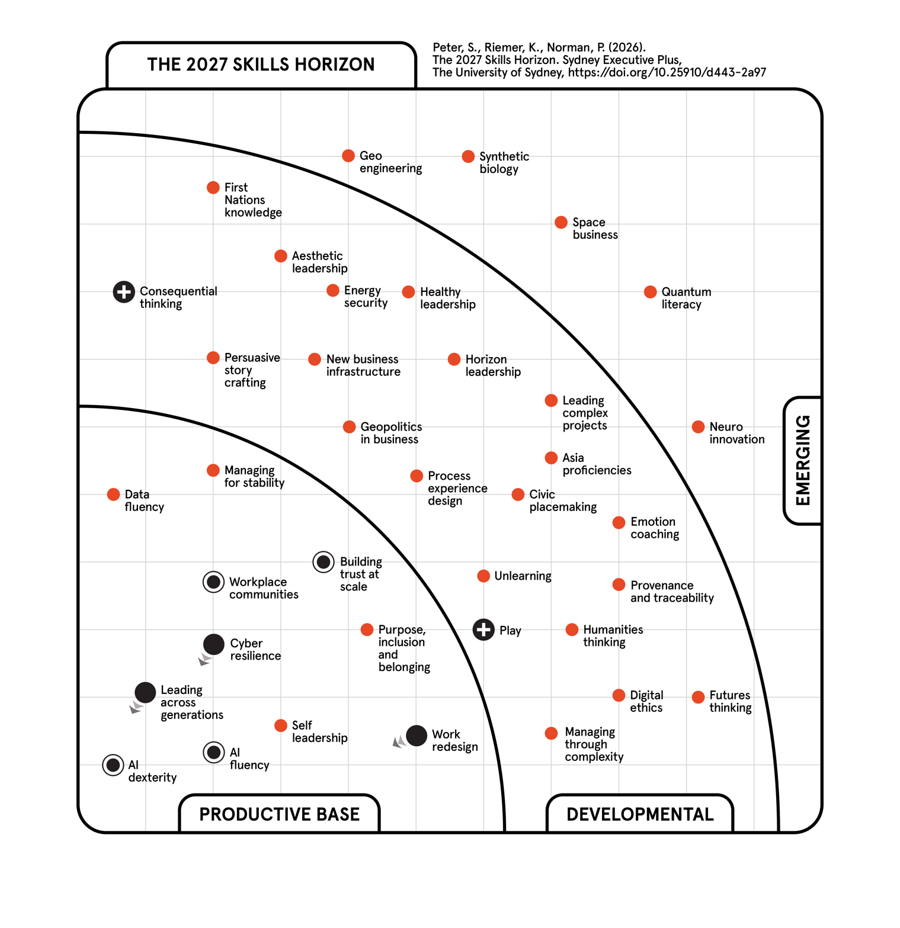

Slide 5
Plan. Learn. Make. Play.
PLAN IS COORDINATION
Calendars, inboxes, forms. It expands to fill the space you give it, and it’s the part most exposed to Agentic AI. Use AI to compress this work, not do more admin faster.
LEARN IS YOUR INPUTS
Reports, briefings, the article someone sent you weeks ago. AI summarises well, but when you’re learning, productive struggle
is the point. Use AI to support, not replace.
“Where does AI fit?” is the wrong question. Your day isn’t one thing—split it four ways and the question becomes answerable.
P
L
MAKE IS OUTPUT
The spreadsheet, the deck, the strategy paper. Treat AI as a sharp junior colleague: hand over chunks but keep your hand on
the wheel.
PLAY IS OPEN-ENDED
Brainstorming, modelling scenarios, testing an argument before your board does. This is the strategic—and fun—stuff. Use AI as a sparring partner, not the thinker.
M
P

Slide 6
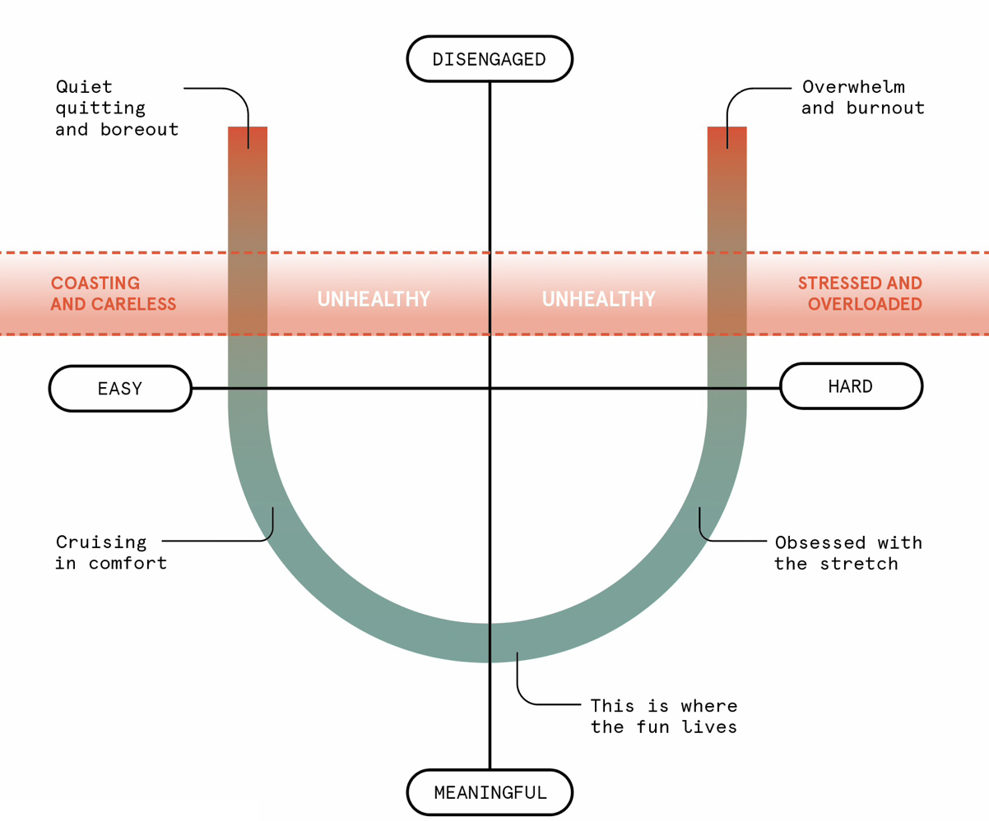
The horseshoe of meaningful work
Meaningful work lifts engagement, effectiveness, and productivity. Meaningless work breeds burnout… and vibers.
Both ends of the horseshoe have
bad outcomes for your organisation.
Design accordingly.

Slide 7
Agents vs Agentic work
AGENTIC AI refers to the most advanced use of generative AI. At the core of Agentic AI is the same probabilistic technology that powers AI chatbots—highly capable AI models, such as large language models (LLMs) or multi-modal foundation models which handle different types
of data.
Agentic AI comes in two main flavours, depending on who’s in charge:
AI AGENTS are used to automate tasks or entire processes. Here, software is in charge of executing task sequences autonomously. To achieve this, the AI model is wrapped in conventional, deterministic software (called a harness) that provides controls and guardrails to keep the AI model on track.
AGENTIC WORK (also called co-work) enables knowledge workers to hand off tasks to the Agentic AI system. The system has access to files, tools, or (parts of) the user’s computer, but the user stays firmly in charge, prompts the system, and reviews the outputs.
01
02
AI models are powerful across a vast range of tasks. But they are by nature probabilistic, which means they hallucinate and lack the reliability of conventional computing. To make AI agents reliable they are typically restricted to well-defined, narrow tasks and tightly controlled. Agentic work is far more universal but keeps the human firmly in charge to retain the responsibility of checking all outputs in
the flow of work.

Slide 8
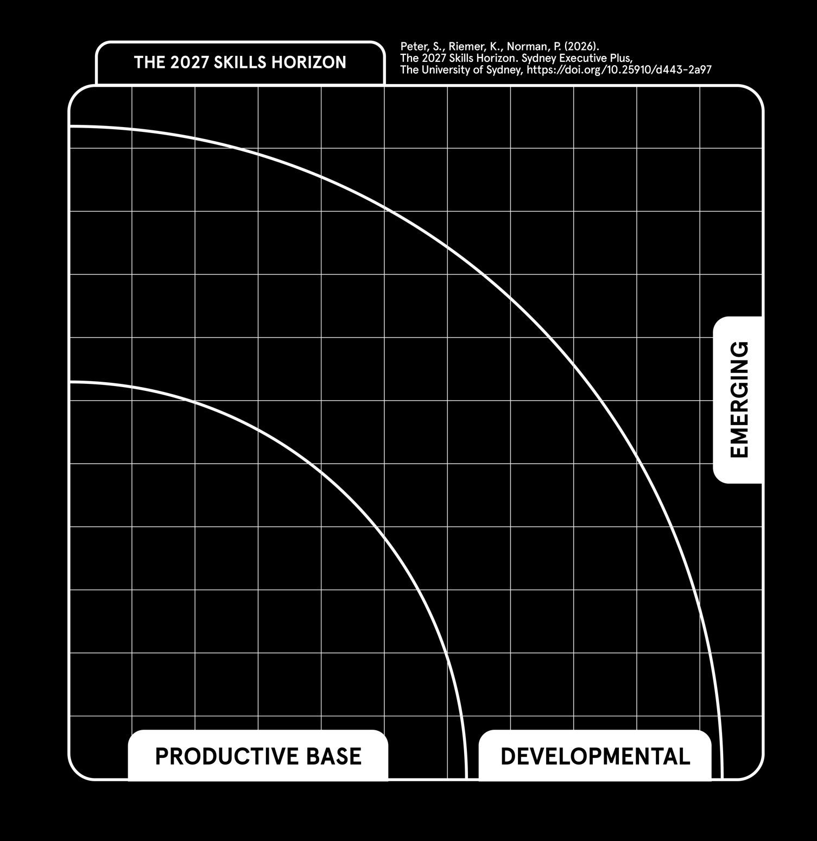

SPACE
BUSINESS
BLOB 1
Speaking the
language of tech
NEW BUSINESS
INFRASTRUCTURE
PROCESS
EXPERIENCE
DESIGN
DATA
FLUENCY
You need
more than a token strategy
CYBER
RESILIENCE
AI
FLUENCY

Slide 9
+ Speaking the language of tech, in numbers
AI INVESTMENT
DOMINATES
$750B
combined capital expenditure across Amazon, Google, Meta, Microsoft, and Oracle in 2026 (The Economist 2026).
EXPONENTIAL GROWTH
IN AI CHIPS
10x
Increase since 2024 in H100 equivalent NVIDIA AI chips in use (20m chips today), and projected growth to 2028 (NYT 2026).
AI TOKEN COST
EXPLOSION
93%
of respondents in a recent survey say they exceeded their AI budgets (McKinsey 2026b).
AGENTS ARE ON THE RISE…
15x
YoY increase in AI agents in the Microsoft platform ecosystem (Microsoft 2026).
… BUT STILL HAVE
A WAY TO GO
23%
Share of companies using Agentic AI at least moderately (Deloitte 2026a).
TRANSFORMATION
TRAILS AMBITION
74%
of companies plan to deploy Agentic AI within two years (Deloitte 2026a).
MIND THE AGENTIC RISKS
62%
Security and risk concerns are the main obstacle preventing businesses from reaching the full potential of Agentic AI (McKinsey 2026b).
KEEP AN EYE…
70%
of employees admit they’ve misused AI for sensitive or high-stakes work tasks (GoTo 2026).
YOUR OWN SPACE DATA SOURCE IS NOW AFFORDABLE
–95%
cost per kilogram payload since the space shuttle era; from $55K to $3K (Goldman 2026).
21%
of companies have a mature model for governing autonomous agents (Deloitte 2026a).
… ON UNDERGROUND AI
62%
of Gen Z rate AI tools provided at work as insufficient (Deloitte 2026b).
Notes:
Economist 2026: Companies are scrambling to curtail soaring AI costs, The Economist, 14 Jun 2026, https://www.economist.com/business/2026/06/14/companies-are-scrambling-to-curtail-soaring-ai-costs
NYT 2026: The Impending, Inescapable Deluge of A.I., The New York Times, 29 Jul 2026, https://www.nytimes.com/interactive/2026/07/29/technology/ai-chips-data-center-boom.html
McKinsey 2026b: Is that AI agent worth it? Agentic economics and the modern operating model, McKinsey & Company, 13 July 2026, https://www.mckinsey.com/capabilities/quantumblack/our-insights/is-that-ai-agent-worth-it-agentic-economics-and-the-modern-operating-model
Microsoft 2026: 2026 Work Trend Index Annual Report, Microsoft WorkLab, 5 May 2026, https://www.microsoft.com/en-us/worklab/work-trend-index/agents-human-agency-and-the-opportunity-for-every-organization
Deloitte 2026a: State of AI in the Enterprise, Deloitte Development LLC, Jan 2026, https://www.deloitte.com/content/dam/assets-zone1/au/en/docs/services/consulting/2026/state-of-ai-in-the-enterprise-2026.pdf
GoTo 2026: The Pulse of Work in 2026, GoTo, 12 May 2026, https://www.goto.com/resources/pulse-of-work-2026
Deloitte 2026b: 2026 Gen Z and Millennial Survey, Deloitte Global, 13 May 2026, https://www.deloitte.com/content/dam/assets-shared/docs/campaigns/2026/2026-genz-millennial-survey.pdf
Goldman 2026: How Falling Launch Costs and AI Are Driving the Space Economy, Goldman Sachs, 15 Jul 2026, https://www.goldmansachs.com/insights/goldman-sachs-exchanges/how-falling-launch-costs-and-ai-are-driving-the-space-economy

Slide 10

BLOB 2
Solving problems
of scale
PERSUASIVE
STORY
CRAFTING
GEOPOLITICS
IN BUSINESS
CIVIC
PLACEMAKING
You need
to tell a bigger story
BUILDING
TRUST AT
SCALE
PROVENANCE AND
TRACEABILITY
HUMANITIES
THINKING

Slide 11
+ Solving problems of scale, in numbers
COMMUNITY PESSIMISM
IS PREVALENT
TRUST RETRACTS TO NARROW POCKETS
PUBLIC AI SENTIMENT
IS SOURING
32%
70%
44%
38%
41%
of people believe the next generation will be better off, with the biggest declines in India and China
(Edelman 2026).
of people retreating into smaller, familiar, values-aligned circles (Edelman 2026).
of Australians see AI as
a risk (Politico 2026b),
could go either way:
28% are conflicted
and 10% unsure.
of UK respondents see more disadvantage than advantage in AI; 40% are on the fence (LSE 2026).
DATA CENTRES
GENERATE BACKLASH
NO CLEAR JOB IMPACTS FROM AI SO FAR…
NOSTALGIA
IS BACK
PEOPLE WANT BUSINESS LEADERS TO ACT
71%
2%
68%
71%
of US respondents (strongly or somewhat) oppose data centres
in their area (Gallup 2026c).
lower growth in Australian jobs most exposed to AI since launch of ChatGPT in November 2022 (DEWR 2026).
of US respondents say nostalgia influences purchase behaviour at least a little (17% say “a lot”, and rising) (CivicScience 2026).
grant organisational leaders a
mandate to act on societal issues (Edelman 2025).
5.6%
78%
growth in most exposed fifth of occupations since November 2022 (DEWR 2026).
trust their employer to do what’s right (Edelman 2026).
Notes:
Edelman 2026: 2026 Edelman Trust Barometer, Edelman Trust Institute, Jan 2026, https://edl.mn/4stxw32
Politico 2026b: Australians see AI as a risk, but not for the reasons you might think, Politico, 20 Aug 2026, https://www.politico.com/news/2026/08/20/australia-artificial-intelligence-public-opinion-01043248
LSE 2026: AI has a serious image problem, LSE Business Review, 7 Aug 2026, https://blogs.lse.ac.uk/businessreview/2026/08/07/ai-has-a-serious-image-problem/
Gallup 2026c: Americans Oppose AI Data Centers in Their Area, 13 May 2026, https://news.gallup.com/poll/709772/americans-oppose-data-centers-area.aspx
DEWR 2026: AI and employment in Australia, Department of Employment and Workplace Relations, 30 Jun 2026, https://www.dewr.gov.au/workplace-relations/resources/ai-and-employment-australia
CivicScience 2026: The Power of the Past: How Nostalgia Is Unlocking Resilient Wallets and New Market Opportunities in 2026, Civic Science, 25 Jun 2026, https://civicscience.com/the-power-of-the-past-how-nostalgia-is-unlocking-resilient-wallets-and-new-market-opportunities-in-2026/
Edelman 2025: 2025 Edelman Trust Barometer, Edelman Trust Institute, Jan 2025, https://edl.mn/4iPYeyf

Slide 12

BLOB 3
Working across
difference
HORIZON
LEADERSHIP
You need
to lead,
and let lead
MANAGING
FOR STABILITY
WORKPLACE
COMMUNITIES
PLAY
LEADING
ACROSS
GENERATIONS
PURPOSE,
INCLUSION
AND BELONGING

Slide 13
+ Working across difference, in numbers
LEADERSHIP
DEVELOPMENT IS
NOW A TOP CONCERN
80%
of HR leaders lack confidence in
their leadership pipelines; CEOs
rank leadership development as
a top four concern (DDI 2025b).
MANAGERS DO
MANY THINGS,
EXCEPT LEAD PEOPLE
41%
Proportion of their time managers actually spend on people, rather than other things (Capterra 2024).
MIDDLE MANAGERS
ARE OVERWHELMED
75%
of middle managers showed signs of overwhelm severe enough
to affect how they manage
(Sinek 2025).
YOUNG LEADERS ARE
LOOKING ELSEWHERE
>40%
of managers with less than two years in the role are looking to do something else (but only 20% among leaders with 10+ yrs’ experience) (Capterra 2024).
OR DON’T WANT TO LEAD AT ALL
1.7x
Gen Z are much more likely to turn down a leadership role than others (DDI 2025a).
PEOPLE WANT DIVERSITY
78%
of people say they are more productive when they work with others who hold different viewpoints (Randstad 2026).
WORK-LIFE BALANCE
IS A TOP MOTIVATOR
46%
Work-life balance beats job security and pay (both 23%) as
top reason for staying at jobs (Randstad 2026).
BUT LONG HOURS
A TURN-OFF
51%
Long hours are the largest
source of work stress for Gen Z (Deloitte 2026b).
CONNECT LEADERSHIP
TO PURPOSE
79%
of Gen Z want work that’s about helping or making a positive difference in people’s lives (Gallup 2026e).
BUT THEY DON’T TRUST IT
42%
would rather move departments than report to a manager who doesn’t share their values (Edelman 2026).
Notes:
DDI 2025b: Global Leadership Forecast 2025, DDI, 22 Jan 2025, https://media.ddiworld.com/research/global-leadership-forecast-2025-report.pdf
Capterra 2024: How HR Can Help the Overworked, Underappreciated Middle Manager, Capterra, 13 Feb 2024, https://www.capterra.com/resources/middle-manager-burnout-strategies/
Sinek 2025: 6 Shocking Stats That Prove Middle Managers Are in Crisis, Simon Sinek's Optimism Company, 10 Sept 2025, https://simonsinek.com/stories/6-shocking-stats-that-prove-middle-managers-are-in-crisis
Capterra 2024: How HR Can Help the Overworked, Underappreciated Middle Manager, Capterra, 13 Feb 2024, https://www.capterra.com/resources/middle-manager-burnout-strategies/
DDI 2025a: Conscious Unbossing: Rebuilding the Leadership Pipeline for a New Generation, DDI, 4 Mar 2025, https://www.ddi.com/blog/conscious-unbossing
Randstad 2026: Randstad Workmonitor 2026: the great workforce adaptation, Randstad, 2026, https://www.randstad.com/workmonitor/
Edelman2026: 2026 Edelman Trust Barometer, Edelman Trust Institute, Jan 2026, https://edl.mn/4stxw32
Deloitte 2026b: 2026 Gen Z and Millennial Survey, Deloitte Global, 13 May 2026, https://www.deloitte.com/content/dam/assets-shared/docs/campaigns/2026/2026-genz-millennial-survey.pdf
Gallup 2026e: Many Gen Zers Missing Sense of Meaning or Purpose in Life, Gallup, 23 Jun 2026, https://news.gallup.com/poll/711836/gen-zers-missing-sense-meaning-purpose-life.aspx

Slide 14

AESTHETIC
LEADERSHIP
BLOB 4
CONSEQUENTIAL
THINKING
Thinking through
complexity
You need
to make sense
UNLEARNING
SELF
LEADERSHIP
FUTURES
THINKING
MANAGING
THROUGH
COMPLEXITY

Slide 15
+ Thinking through complexity, in numbers
SOCIAL MEDIA
NOW #1 NEWS
SOURCE GLOBALLY
54%
of respondents get news from social and video sites, ahead of news sites (51%) (Reuters 2026a).
TRUST IN NEWS
REACHES A
NEW LOW
37%
of people globally trust the news—the lowest level yet (Reuters 2026a).
CONSUMING AI
CONTENT IS NOW
A COIN FLIP
52%
of new online content
is now AI-generated (Axios 2025).
INTERNAL DATA QUALITY INCREASINGLY QUESTIONABLE…
61%
of leaders question data reliability about people and performance (Deloitte 2026d).
… AND HARD TO RECTIFY
5%
of organisations making real progress addressing quality of this data
(Deloitte 2026d).
PARALYSED BY DATA…
72%
of leaders say volume and lack of trust in data stopped them making a decision (Oracle 2023).
MORE JUDGEMENT
IS NEEDED
59%
of employers rate “judgement and decision making” as more important than a year ago (ZipRecruiter 2026).
UNCERTAINTY IS UP…
10x
rise in economic policy uncertainty in the past decade (EPU 2026).
A LEADER’S
LIFE IS COMPLEX
59%
of CEOs say expectations and complexity of their role grew significantly in the last five years (KPMG 2025).
… AND AI
41%
of respondents say AI increased the time spent making decisions (BCG 2026a).
… AND BEING FELT
43%
of US CEOs named “uncertainty” as the one external factor with greatest negative impact (ConfBoard 2026).
Notes:
Reuters 2026a: Reuters Institute Digital News Report 2026, Reuters Institute for the Study of Journalism, University of Oxford, Jun 2026, https://ora.ox.ac.uk/objects/uuid:bdec3e82-9aee-4301-9556-9d908881c74a
Axios 2025: AI writing hasn't overwhelmed the web yet, Axios, 14 Oct 2025, https://www.axios.com/2025/10/14/ai-generated-writing-humans
Deloitte2026d: Fact or fabrication? AI is blurring the line when it comes to people and work, Deloitte Insights, 4 Mar 2026, https://www.deloitte.com/us/en/insights/topics/talent/human-capital-trends/2026/managing-disinformation-at-scale.html
Oracle 2023: Global Study: 70% of Business Leaders Would Prefer a Robot to Make Their Decisions, PR Newswire, 19 Apr 2023, https://www.prnewswire.com/news-releases/global-study-70-of-business-leaders-would-prefer-a-robot-to-make-their-decisions-301799591.html
BCG 2026a: AI at Work: Strategy Matters More Than Tools, Boston Consulting Group, 3 Jun 2026, https://www.bcg.com/publications/2026/ai-at-work-why-strategy-matters-more-than-tools
ZipRecruiter 2026: More Jobs, Higher Bar: The 2026 AI Employer Report, ZipRecruiter Economic Research, 29 Jul 2026, https://www.ziprecruiter-research.org/economic-insights-research/ai-employer-report-2026
EPU2026: Economic Policy Uncertainty Index, Economic Policy Uncertainty, date accessed 26 August 2026, https://www.policyuncertainty.com/index.html
ConfBoard 2026: The CEO Playbook for 2026, The Conference Board, 15 Jan 2026, https://www.conference-board.org/publications/C-Suite-Outlook-2026-Uncertainty-and-Opportunity
KPMG 2025: KPMG 2025 Global CEO Outlook, KPMG, 2025, https://kpmg.com/xx/en/our-insights/value-creation/global-ceo-outlook-survey.html

Slide 16

CONSEQUENTIAL
THINKING
BLOB 5
Leading the AI
transition
MANAGING
FOR STABILITY
You need
to clean up the mess
UNLEARNING
PLAY
AI
DEXTERITY
WORK
REDESIGN

Slide 17
+ Leading the AI transition, in numbers
ADOPTION IS NO LONGER
YOUR #1 ISSUE…
58%
of employees report regular, intentional AI use (Melbourne Uni 2025).
WORKSLOP
ERODES TRUST
42%
of workers who received workslop say AI-using colleagues are less trustworthy (Futurism 2025).
YOU NEED TO CLEAN UP
AFTER YOUR BOT
87%
of workers say AI outputs regularly need revisions (GoTo 2026).
YOUR WORK
IS GETTING HARDER
50%
of leaders report spending more time reviewing and correcting AI output (41% say it increased decision times) (BCG 2026a).
WORK IS CHANGING FAST…
49%
of workers globally are experiencing change in how work is being done (Deloitte 2026c).
AI IS
A PEOPLE ISSUE
59%
of CEOs say CHROs’ influence over AI will increase in the years ahead (IBM 2026a).
AI SKILLS LEVELS
ARE STILL LOW…
24%
of Australian workers have received
AI training (US: 28%, UK: 27%)
(Melbourne Uni 2025).
LEARNING
IS REQUIRED…
88%
of workers say they need major upskilling in the next five years
(only 36% feel properly skilled) (BCG 2026a).
… BUT INCENTIVES TO REDESIGN ARE LACKING
13%
of users say they’re rewarded for reinventing work with AI even if results aren’t met (45% feel safer doing business as usual) (Microsoft 2026).
… BUT NOT EVERYWHERE
64%
of workers in China and India have received training (Melbourne Uni 2025).
Notes:
Melbourne Uni 2025: Trust, attitudes and use of artificial intelligence: A global study 2025, The University of Melbourne and KPMG, 2025, https://mbs.edu/-/media/PDF/Research/Trust_in_AI_Report.pdf
Futurism2025: Companies Are Being Torn Apart by AI “Workslop,” Stanford Research Finds, Futurism, 23 Sep 2025, https://futurism.com/future-society/ai-productivity-research
GoTo2026: The Pulse of Work in 2026, GoTo, 12 May 2026, https://www.goto.com/resources/pulse-of-work-2026
BCG 2026a: AI at Work: Strategy Matters More Than Tools, Boston Consulting Group, 3 Jun 2026, https://www.bcg.com/publications/2026/ai-at-work-why-strategy-matters-more-than-tools
Deloitte2026c: 2026 Global Human Capital Trends, Deloitte Insights, 4 Mar 2026, https://www.deloitte.com/us/en/insights/topics/talent/human-capital-trends.html
Microsoft 2026: 2026 Work Trend Index Annual Report, Microsoft WorkLab, 5 May 2026, https://www.microsoft.com/en-us/worklab/work-trend-index/agents-human-agency-and-the-opportunity-for-every-organization
IBM 2026a: IBM Study: CEOs are Reshaping C-suite Roles for the AI Era, IBM, 4 May 2026, https://newsroom.ibm.com/2026-05-04-ibm-study-ceos-are-reshaping-c-suite-roles-for-the-ai-era
BCG 2026a: AI at Work: Strategy Matters More Than Tools, Boston Consulting Group, 3 Jun 2026, https://www.bcg.com/publications/2026/ai-at-work-why-strategy-matters-more-than-tools

Slide 18
The Provocative Leader
In a disorienting world, your people look to you for ideas, stability, and direction. In 2027, it’s The Provocative Leader who’ll be best positioned to engage, guide, and inspire the team.
PROVOCATIVE LEADERS…
TELL IT LIKE IT IS
Develop the habit of being forthright with your team, even if it’s uncomfortable. And there’s enough complexity to deal with, so keep it simple, accessible, and good-humoured where you can.
USE THE POWER
OF PLAY
Develop the habit of playfully testing and challenging the thoughts, assumptions, and expectations of your peers and your people. And, importantly, apply that same scrutiny to yourself. Try new things or approaches at work to keep yourself fresh.
ARE INVOLVED
Develop the habit of trying out new tools, so you know where things are headed. Try to join your team where possible—as a participant, not just an observer—when they’re exploring new ideas. There’s more fun, and insight, to be had at work.
USE THEIR TASTE
Read widely, even weirdly—outside of your bubble and comfort zone. Look in strange places to cultivate your own perspective on things. Don’t be afraid to use your own judgement.
ARE LIFELONG LEARNERS
Develop the habit of sticking with and working through complex problems, upskilling yourself and your people, and leading by example—have the confidence to change your mind and instil that confidence in others.
01
02
03
04
05

Slide 19
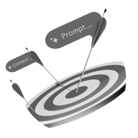









You’ve got the slides. Now get the skills.
AI
fluency
Build an understanding of the opportunities, capabilities and challenges of AI, and engage confidently with key stakeholders.
AI
dexterity
Learn how to prompt, customise, and manage Generative AI tools, and how to lead their responsible adoption across your team.
AI
fluency for
directors
Drive meaningful board conversations about AI governance, risk, and strategic direction.
Innovation
strategy
Turn ideas into outcomes by learning how to structure, sustain, and measure innovation across your organisation.
Leading
tech-enabled
teams
Create an effective team that thrives in a tech-driven world and transform your leadership for the AI era.
Quantum
opportunities
Understand quantum computing and prepare your organisation for the opportunities and risks of quantum disruption.
Geopolitics
and
business
Learn strategies and tools for navigating geopolitical risk, international politics, and the
global economy.
Communities
at work
Create thriving workplace cultures through community principles that drive engagement, innovation, and sustainable collaboration.
Leading
complex
projects
Enhance skills in navigating complexity and driving success
in large-scale projects across various sectors.
Net
Zero
Learn how to account, report,
and act on your business’ carbon emissions—and make the transition to net zero.
Learn more and enrol: plus.sydney.edu.au/our-sprints
Get in touch with us: executive.plus@sydney.edu.au
Notes:
Learn more: https://plus.sydney.edu.au/our-sprints

